Slide 1
SYSTEM REQUAIREMENT SPECIFICATION
Faculty Management System
Adarsh M S
Devanarayanan TM
Rinu Jauhar
Sreekanth CS

Slide 2
CONTENTS
PROBLEM STATEMENT
OBJECTIVES
MOTIVATION
FUNCTIONAL REQUIREMENTS
NONFUNCTIONAL REQUIREMENTS
TIMELINE

Slide 3
PROBLEM STATEMENT
The Faculty Management System is a software application that aims to streamline the administrative and academic activities of educational institutions. Many educational institutions struggle to maintain faculty data and it’s effective organizing . It becomes difficult when we require searching ,sorting etc for many purpose like NAAC and NBA accreditations. To address these challenges, there is a need for a faculty management system that enables educational institutions to make an easy and efficient way for faculty management.

Slide 4
OBJETIVES
The objective of this system is to automate the manual processes involved in managing faculty members' personal information, qualifications, professional experience, publications, and awards.
The intended audience of the system is the faculty members, administrative staff, and management of educational institutions.

Slide 5
SCOPE
Making the accreditation works easy
Faculty Management System is to automate and streamline various faculty-related processes and information management tasks, providing a centralized platform for faculty management in academic institutions.
The system should be able to evaluate faculty performance based on various metrics such as teaching quality, research output, and service to the institution.
Provide notification system and academic calendar
5

Slide 6
STAKEHOLDER IDENTIFICATION
Principal
Dean
HOD
Faculty
Members in accreditation program
6
6

Slide 7
MOTIVATION
Lack of proper faculty data management
Current difficulties facing during accreditation process
Beneficial to the faculties in the college
Easy and efficient way of retrieving faculty information

Slide 8
Functional Requirements
Login
The system should allow registered users to log in to the system by providing their faculty id and password.
The system should verify the user’s faculty id and password against the database.
The system should allow the user to reset their password if they forget it.

Slide 9
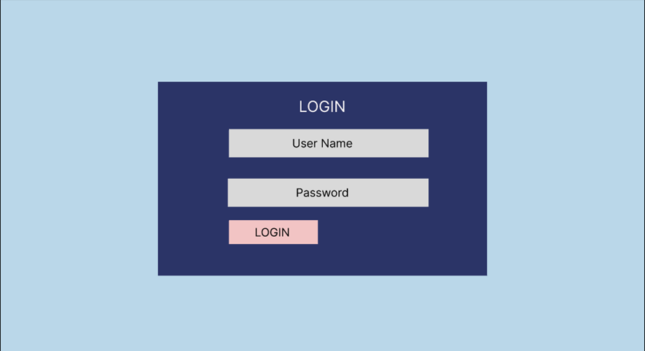

Slide 10
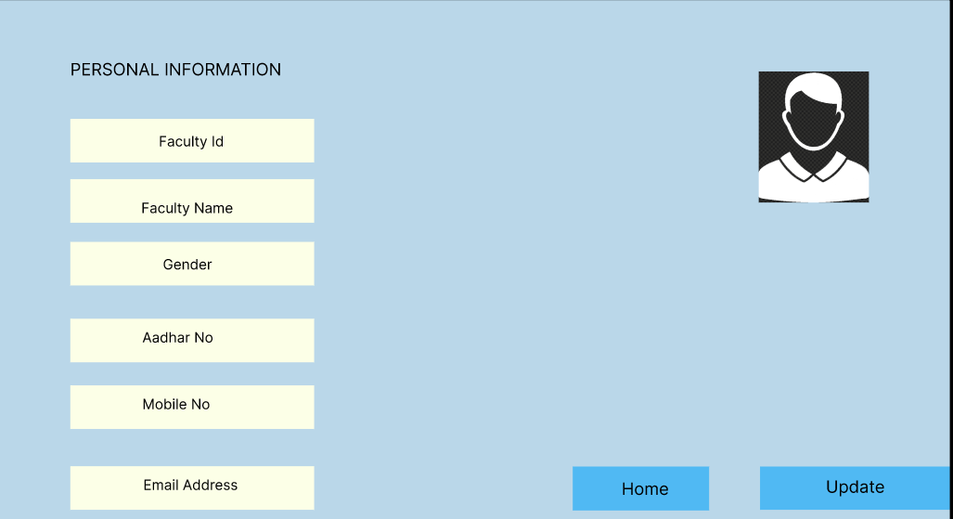
Personal Information
The system should allow faculty members to create and maintain their personal profiles.
The personal details should include the faculty member's ID, name, date of birth, designation, staff type, email, and date of joining.
The system should allow the faculty members to update their personal information.

Slide 11
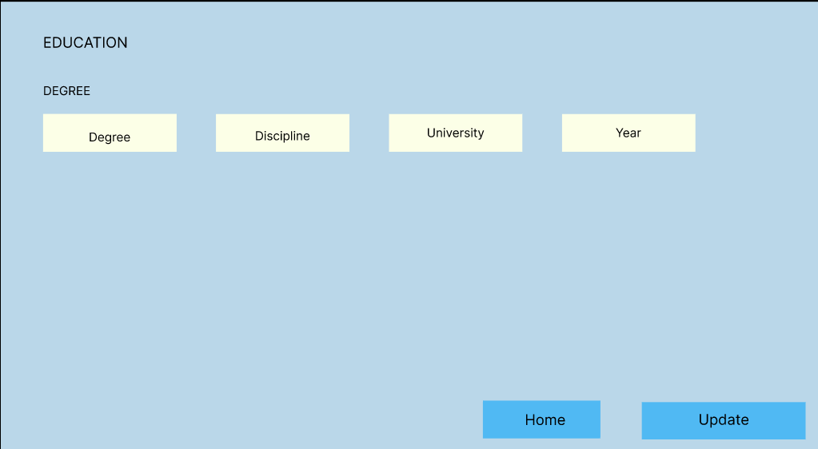
Qualifications
The system should allow faculty members to enter their educational qualifications, including their degrees, universities, specializations, and years of completion.
The system should allow the faculty members to upload their degree certificates for verification purposes.
The system should allow the faculty members to update their qualifications.

Slide 12
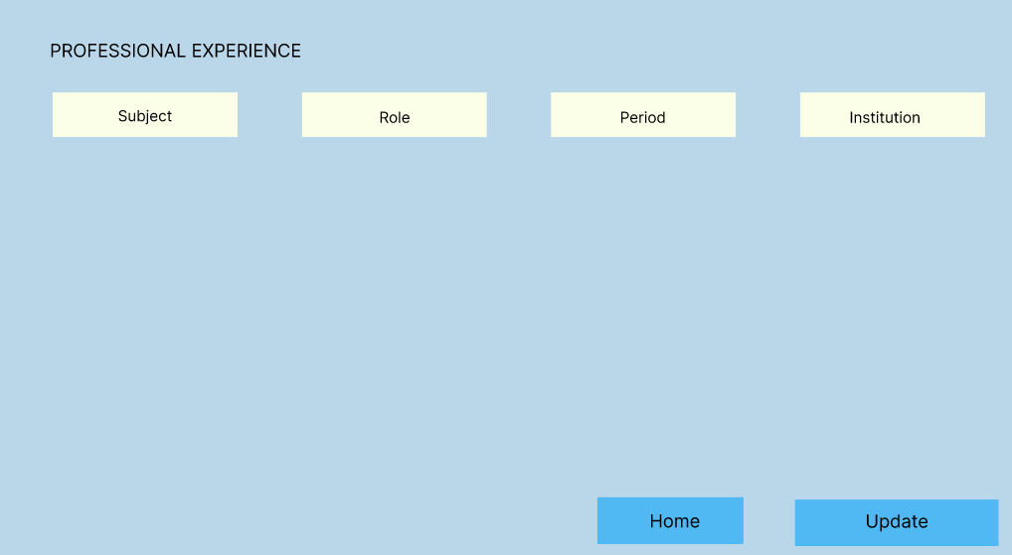
Professional Experience
The system should allow faculty members to enter their professional experience, including their employment history, job titles, and dates of employment.
The system should allow the faculty members to upload their work experience certificates for verification purposes.
The system should allow the faculty members to update their professional experience.

Slide 13
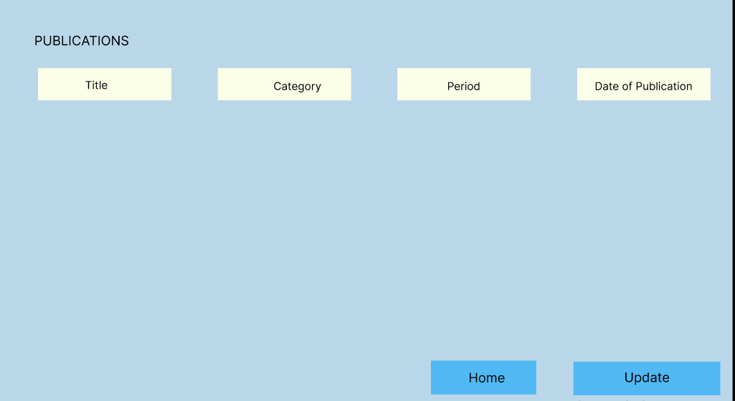
Publications
The system should allow faculty members to enter their publications, including their research articles, books, and conference papers.
The system should allow the administrative staff to review and approve the entered publications.
The system should notify the faculty members of the status of their entered publications.
The system should allow the faculty members to update their publications

Slide 14
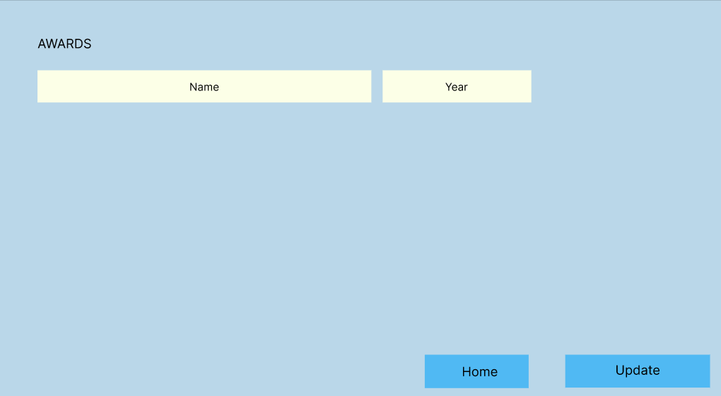
Awards
The system should allow faculty members to enter their awards and honors, including their research grants, fellowships, and scholarships.
The system should allow the administrative staff to review and approve the entered awards.
The system should notify the faculty members of the status of their entered awards.
The system should allow the faculty members to update their awards

Slide 15
Non-Functional Requirements
Performance
The system should have a response time of less than 2 seconds for all operations.
The system should be able to handle a minimum of 100 concurrent users.
Security
The system should use encryption to protect the faculty members' personal information.
The system should have role-based access control to restrict access to sensitive data
.The system should use hashing to store the login credentials in the database

Slide 16
Usability
The system should have a user-friendly interface that is easy to navigate.
The system should provide online help and tutorials for the users.
Reliability
The system should have a backup and recovery mechanism to ensure data availability in case of system failure.
The system should be available 24/7, except during scheduled maintenance.

Slide 17
System Architecture
The system should be a web-based application built on a three-tier architecture
The system should use a relational database management system (RDBMS) to store and manage the data
The system should be compatible with commonly used web browsers

Slide 18
User Interface Design
The user interface should have a modern and responsive design.
The user interface should have a dashboard that provides quick access to all the system features

Slide 19
Data Management
The system should use an RDBMS to store and manage the data
The system should have data backup and recovery mechanisms in place
The system should allow the faculty members to update or modify their personal information, qualifications, professional experience, publications, and awards

Slide 20
TIMELINE
1.Requirement analysis
2.UI Creation
3.Developing Phase
4.Deployment
5.Maintanance

Slide 21
TOOLS USED
ReactJS
The front end of the web application is built using the ReactJS framework
ExpressJS
ExpressJS will be used to build the backend server of the application
Express helps to build a REST API backend on top of nodejs
MySQL
A MySQL database hosted on the AWS will be used to store the data

Slide 22
CONCLUSION
Faculty Management System is to automate and streamline various faculty-related processes and information management tasks, providing a centralized platform for faculty management in academic institutions.
Limit the current difficulties facing during accreditation process
The system should be able to generate analytics on various aspects of faculty management, such as faculty performance, attendance, payroll, and benefits.
22
22

Slide 23

T
H
A
N
K
Y
O
U

